Slide 1


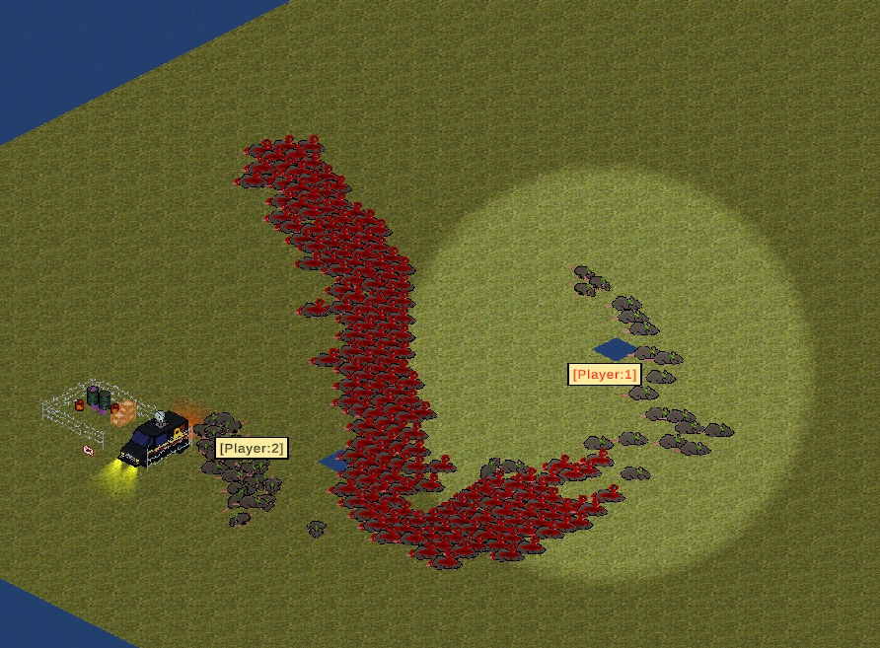

PESTIS: Rat Domination
Team Pickled Rat
Murray, Ani, Harvey, Chongsheng, Shayaan, Vinh

